Slide 1
CYBERSECURITY
VULNERABILITY REPORT
ORGANIZATION: OLASHORE INT.L SCHOOL
PREPARED BY: CYBERKNIGHTSONE {HAASTRUP A. DAVID}
DATE: 9/2/2026

Slide 2
VICTIM: www.olashoreschool.com
THIS IS THE SCHOOL’S WEBSITE ADDRESS.
TARGET
INFORMATION
I.P ADDRESS: 64.29.17.1
THIS IS THE I.P ADDRESS OF THE SCHOOL’S WEBSITE.

Slide 3
VULNERABILITY DESCRIPTION
1. HTTP PORT (80) OPEN TO DoS/DDoS ATTACKS
2. HACKERS OR THREAT ACTORS CAN OVERWHELM SERVER TRAFFIC

Slide 4


DEFINITION OF DoS ATTACK
IT OVERWHELMS THE SERVER WITH EXCESSIVE REQUESTS
CAUSES INSTABILITY, DOWNTIME OR UNAVAILABILITY
THIS PARTICULAR ATTACK THREATENS THE AVAILABILITY ASPECT OF THE C.I.A TRIAD.

Slide 5
RISK/IMPACT
SLOW PERFORMANCE
WEBSITE UNAVAILABILITY
EVEN IF THE WEBSITE SERVER CAN HANDLE ALL THE REQUESTS, IT WILL LIKELY BE SLOW
DUE TO THE HUGE TRAFFIC THAT WILL LIKELY FLOOD THE SITE, THE WEBSITE WILL JUST SHUT DOWN WITH A 4xx/5xx RESPONSE

Slide 6
RISK/IMPACT CONT.D
LOSS OF PRODUCTIVITY
RECOVERY COSTS
REPUTATIONAL DAMAGE

Slide 7
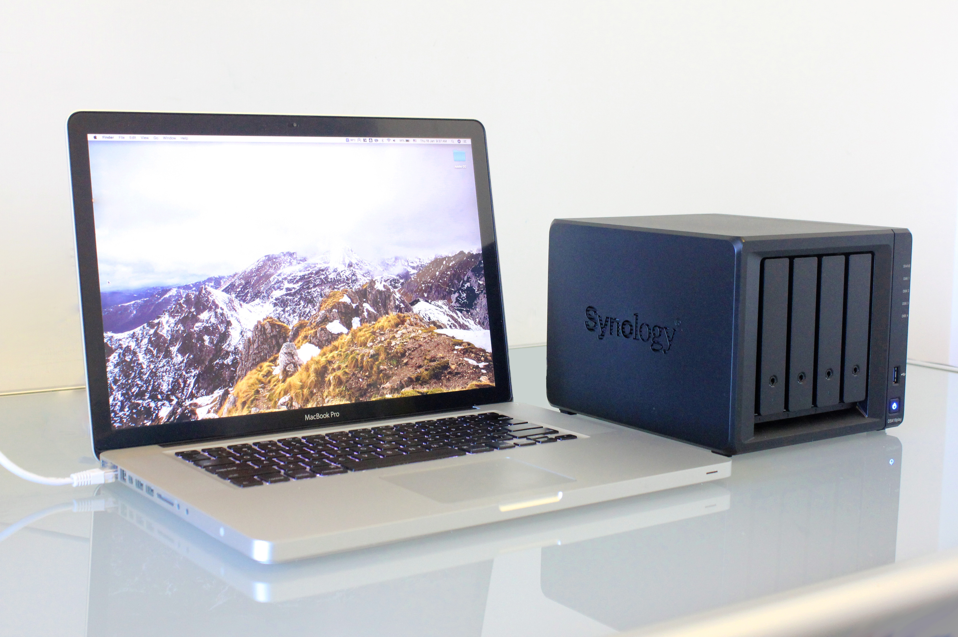
SECURITY ASSESSMENT
SECURITY LEVEL: MEDIUM
RISK CAN BE REDUCED WITH THE PROPER CONTROLS AND MITIGATION PROTOCOLS, IF THE ORGANIZATION PAYS CLOSE ATTENTION TO IT

Slide 8
RECOMMENDATIONS
DEPLOY DoS/DDoS PROTECTION I.E A WEB APPLICATION FIREWALL (WAF)
MONITOR TRAFFIC CONTINUOUSLY
CONFIGURE FIREWALL RULES SO AS TO FILTER TRAFFIC
KEEP SYSTEMS UPDATED REGULARLY
IMPLEMENT RATE FILTERING OR LIMITING
CREATE AN INCIDENT RESPONSE PLAN, BUSINESS CONTINUITY PLAN.

Slide 9
CONCLUSION
IDENTIFIED DoS RISK HIGHLIGHTS NEED FOR PROTECTION
FIREWALL RULES
MONITORING
UPDATES
DDoS PROTECTION IMPROVE RESILIENCE

Slide 10
THANK YOU FOR LISTENING

